Slide 1
Lesson 1 – Information Management & Critical Reading
Module 3 – Professional Life

Slide 2

Instruction (15 minutes)
Students work in group of 3 and discuss the following questions:
Have you ever searched information on the Internet?
Do you like searching?
How do you know the information is useful to you?
Have you ever questioned the author?

Slide 3
Information management
01
A
G
E
N
D
A
Critical reading
02

Slide 4
Information management

Slide 5
Information management is a cycle of processes that support the organization's learning activities:
identifying information needs
acquiring information
organizing and storing information
distributing information
using information

Slide 6
Information management
Identifying information needs
What do you already know about the topic?
How do you know it?
How confident are you in this knowledge?
How will you find more information about the topic?

Slide 7
Information management
Acquiring information means finding answers to our questions.

Slide 8
Information management
Ways
Ask
Practice
Experiment
Read
Teach
Write
Reason
Desire
Observe
Listen
Define
Put it in order
Ways to acquire information:

Slide 9
Information management
Organizing and storing information
Use the LATCH principle
Location
Alphabet
Time
Category
Hierarchy
Notes:
Link to details: https://www.lifehack.org/854926/how-to-organize-information

Slide 10
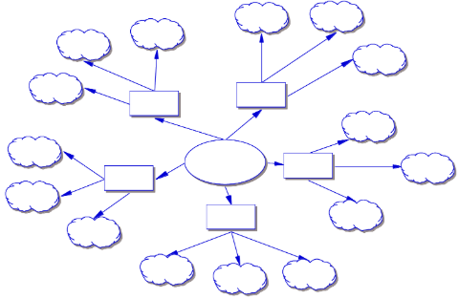
Information management
Organizing and storing information
Use mind-map
Notes:
Link to details: https://www.lifehack.org/854926/how-to-organize-information

Slide 11

Information management
Organizing and storing information
Create list
Notes:
Link to details: https://www.lifehack.org/854926/how-to-organize-information

Slide 12
Information management
Organizing and storing information
Create collections by putting all notes into specific groups of information
Notes:
Link to details: https://www.lifehack.org/854926/how-to-organize-information

Slide 13
Information management
Organizing and storing information
Place priority on key information
Notes:
Link to details: https://www.lifehack.org/854926/how-to-organize-information

Slide 14
Information management
Distributing information
Answer to your trainers’ questions
Answer to your classmates’ questions
Explain the lessons to your friends
Teach juniors what you have learned

Slide 15
Information management
Using information
Students can use the information they have to improve their study, schoolwork, class activities, and learning process.

Slide 16
Critical reading

Slide 17
Critical reading is a process of analysing, interpreting, and sometimes evaluating the text.

Slide 18
Critical reading
To apply critical reading, use the SQ4R Method

Slide 19
Scan
Read
Recite
SQ4R
Review
Question
Reflect

Slide 20
Critical reading
Scan the materials you are going to read:
Table of contents
Introduction or preface
Title
Headings
Graphics

Slide 21
Critical reading
Formulate questions about title and headings:
What
Who
When? Where?
Why? How?

Slide 22
Critical reading
R1: Read
Read and look for the answers to your questions, write down the answers,
make note of the main idea, and
make the summary.

Slide 23
Critical reading
R2: Recite
Look up and briefly recite aloud what the section you read was about

Slide 24
Critical reading
R3: Review
Review your questions and answers and make a cluster of the main ideas

Slide 25
Critical reading
R4: Reflect
Go beyond what you understand from your reading and think
deeply about it

Slide 26
Critical reading
Ask the following questions:
Who is the author?
Who is the audience?
When was it written?
What is the main claim of the reading?
Is the evidence fact, opinion, or personal experience?
Is the evidence accurate?
Are key terms defined?
Does the logic flow?
Is the reading biased?
What are the limitations of the reading?

Slide 27

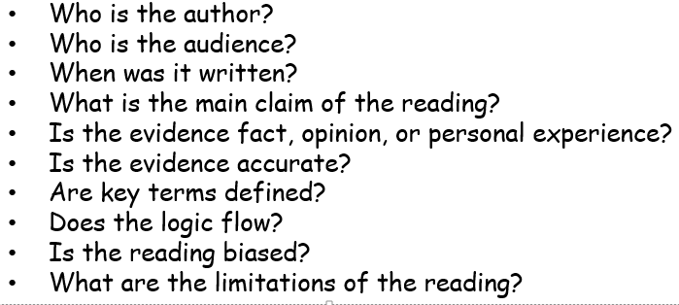
Instruction
Work individually
***Read one article from the Internet and answer the following questions***

Slide 28
Debate Instruction (100 minutes)
Topics: ‘1. Students must wear school uniform.’ ‘2. College students cannot use smart phone at school. ‘3. Smart phone is good for children.’
Must use computer lab
Students work in groups of 4 (six groups).
Group 1 (pro) will debate with Group 2 (Con) on Topic 1.
Group 3 (pro) will debate with Group 4 (Con) on Topic 2.
Group 5 (pro) will debate with Group 6 (Con) on Topic 3.
Each group will have 50mns to search and discuss with their group members before debating.
The group debate will take 35 minutes and be done at the same time due to time constraint.
First, they present their topic.
Second, they can ask questions.
Lastly, they sum up their whole talk and draw conclusion to support their stance.

Slide 29





Thank you !
www.passerellesnumeriques.org

